Slide 1
ML Products
taxonomy, application areas, engineering & tech stack

Slide 2








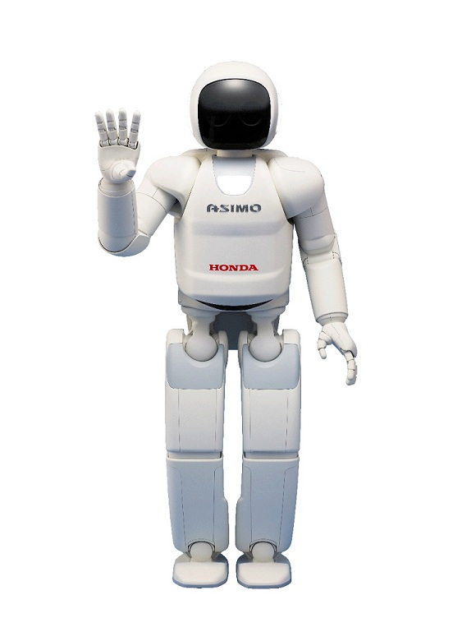





Most Famous Applications
chatbots
recommendations
autonomous driving
translation
robotics
OCR
assistants (speech recognition)
but many more …

Slide 3
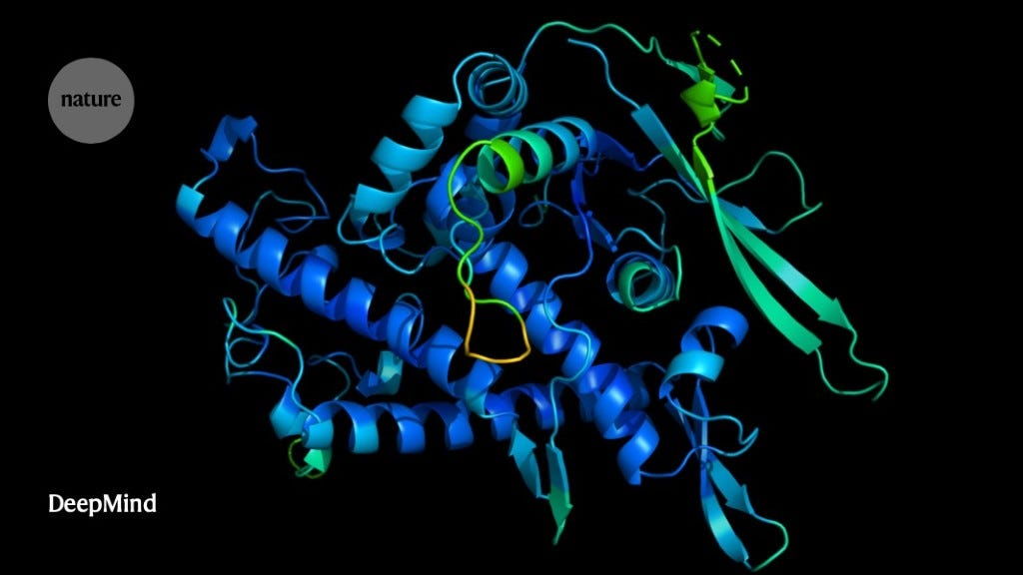
When To Use ML
automation
all applications from previous slide
complexity
protein structure predictions: AlphaFold (GNN)

Slide 4
Taxonomy of ML Models

Slide 5
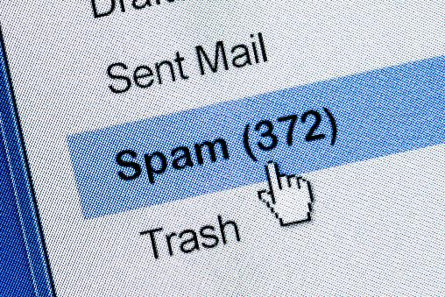
Supervised Learning
Target Quantity
Features
known in training: labeled samples or observations from past
to be predicted for unknown cases (e.g., future values)
input information that is
correlated to target quantity
known at prediction time
Example: Spam Filtering
Classify emails as spam or no spam
use information like occurrence of specific words or email length as features
features x1 and x2 spam, no spam
use accordingly labeled emails as training set
usually rather narrow tasks

Slide 6

Algorithmic Families and Linear Building Blocks
linear (parametric) models
nearest neighbors (local methods, instance-based learning) – non-parametric models
decision trees: rule learning
neural networks: non-linear just by means of activation functions
Day
Weekday
Weekend
3
Promo
No
Yes
demand prediction
5
8
often used in ensemble methods
bagging: random forests
boosting: gradient boosting
from wikipedia
kernel/support-vector machines: linear model (maximum-margin hyperplane) with kernel trick
deep learning: many hidden layers
computer vision: CNN
NLP: transformer
mainly used for structured data

Slide 7
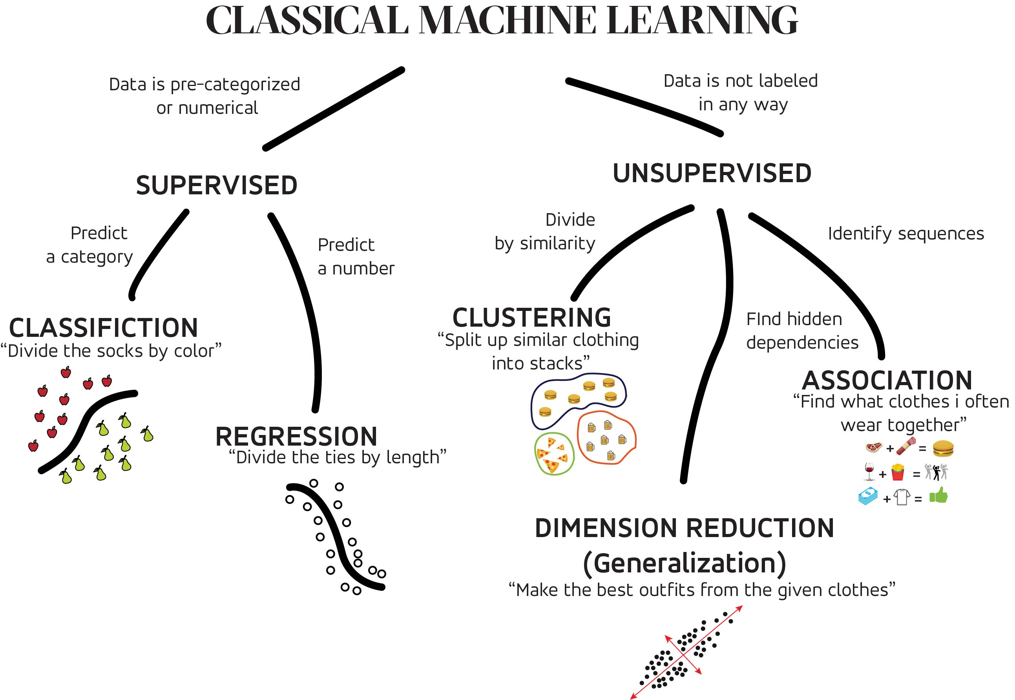
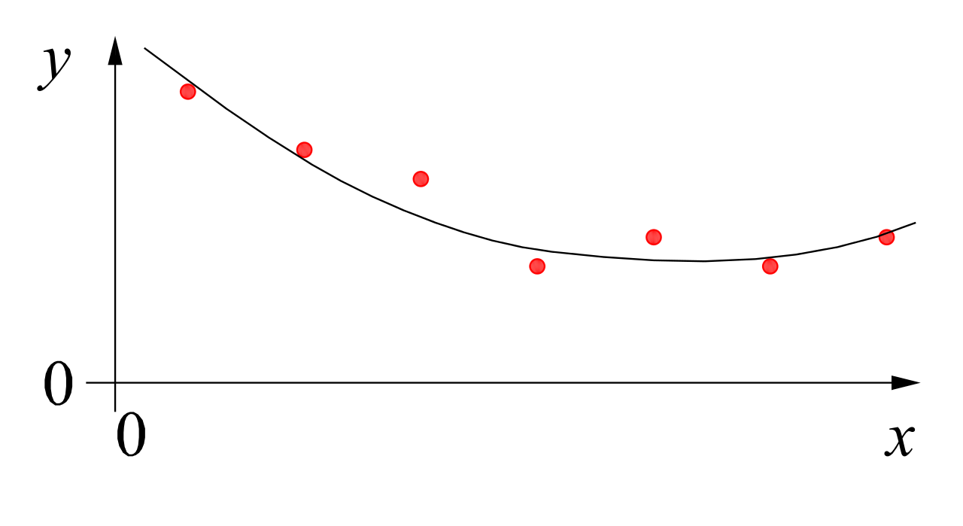


MACHINE LEARNING
no supervision, but goal-based interaction with environment
training target available (labeled or past data)
data not labeled in any way
REINFORCEMENT LEARNING
SUPERVISED
UNSUPERVISED
CLASSIFICATION
ASSOCIATION
CLUSTERING
LEARN STATE OR ACTION VALUES
LEARN POLICY DIRECTLY
REGRESSION
DIMENSIONALITY REDUCTION
learning by teacher
(high-dimensional curve fitting)
learning by observation
(pattern recognition)
learning by trial-and-error
(sequential decision making)
unsupervised and reinforcement learning can both be cast as supervised-learning setup

Slide 8

Classic (Discriminative) Models
discriminative models:
prediction/estimation of labels (classification) or numerical values (regression)
examples for discriminative tasks:
object recognition
demand forecasting
generative models:
generation of new data according to data distribution seen in training
discriminative model
generative model
source

Slide 9
Generative Models
new paradigm for ML workflow:
prompt engineering (low/no code)
instead of classic training (fit) and inference (predict) steps
→ multi-task (and multi-modal) models
instead of narrow use cases of classic models

Slide 10
Under The Hood: Foundation Models
LLMs: transformer models with hundreds of billions of parameters
self-supervised (pre-)training on vast data sets
→ huge foundation models (impossible to train yourself)
usage options:
typical: in-context learning via prompt (potentially giving few examples for task at hand and add retrieval augmentation or tool usage)
for special case and high-quality requirements: fine-tuning on specific tasks and data sets (example: chatbot like ChatGPT via reinforcement learning from human feedback)

Slide 11
Depending on the application, there are currently two dominant approaches for generative AI:
text generation: large language models (LLM)
image synthesis: diffusion models

Slide 12
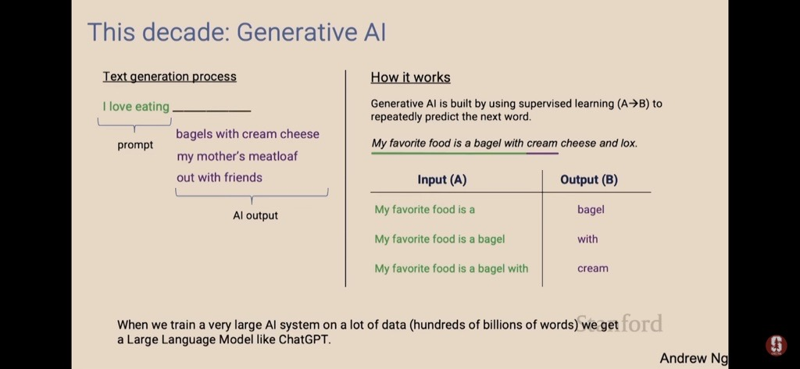
Text Generation

Slide 13

Image Synthesis
example: DALL-E 2
idea: generate new images as variations of training data
condition generation on text prompts: text-to-image
trade-off between diversity and fidelity
SOTA: (guided) diffusion models

Slide 14
classic/discriminative models
generative models
effective for performing numerical and optimization tasks (predictions)
continue to account for majority of AI value in wide range of industries (e.g., supply chain)
→ LLM agents might use prediction or optimization models as tools
not suitable for classical use cases like numerical and optimization tasks
but complimentary: drive value across entire organizations by revolutionizing internal knowledge management systems

Slide 15
Application Areas

Slide 16
Example for Classic Models: Supply Chain
support of operations research
some examples:
warehouse operations and yard management: slotting (e.g., via item affinity), labor management, tracking (computer vision)
transportation (logistics and mobility): routing, ETA (e.g., in Google Maps via GNN), disruption predictions (e.g., stock-outs)
retail: demand forecasting, replenishment, pricing, targeting
Supplier
Manufacturer
Distributor
Retailer
Customer
BULLWHIP EFFECT

Slide 17
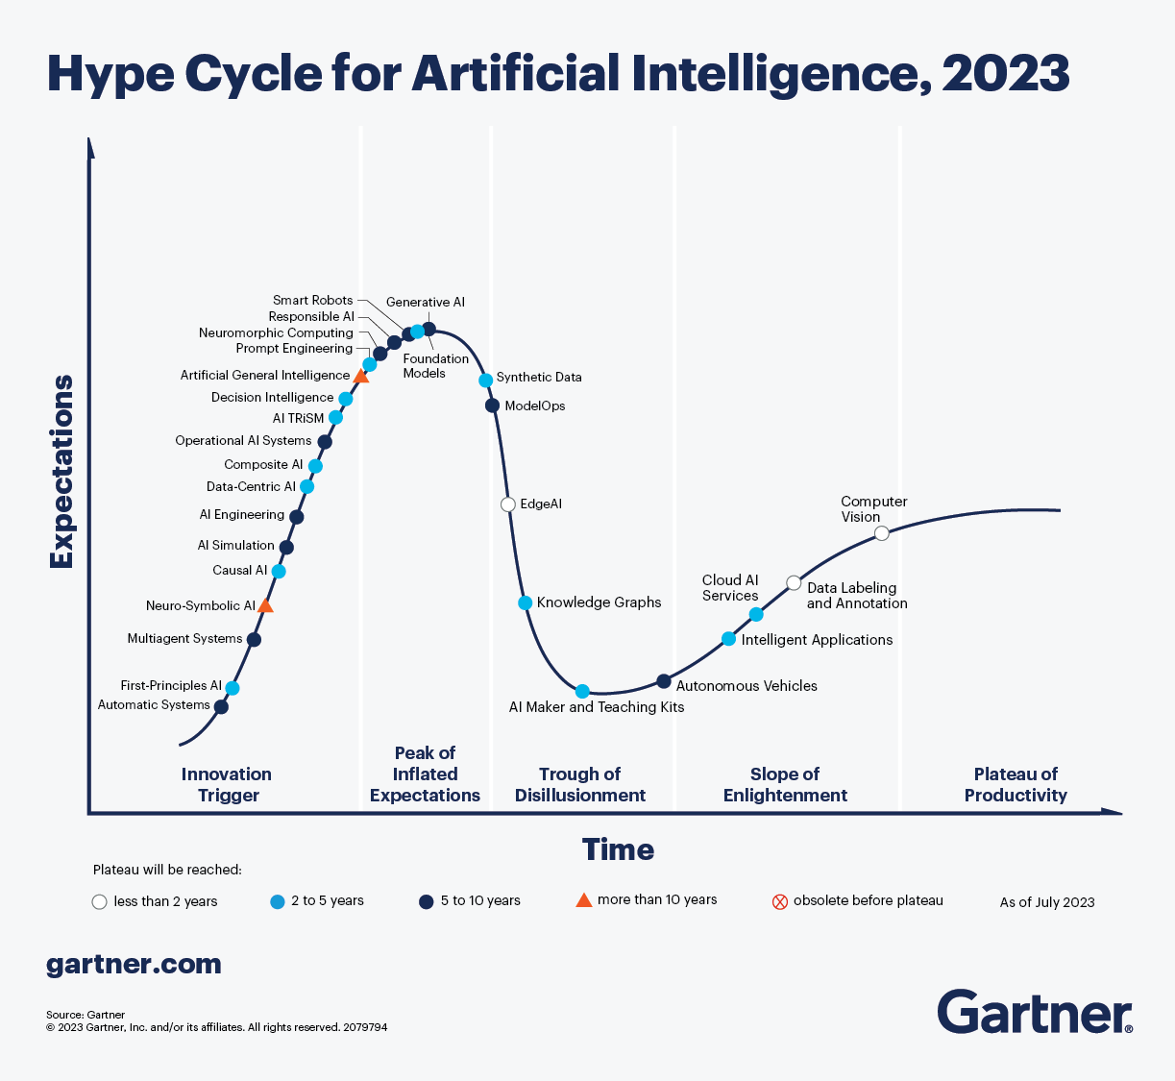
Generative AI at peak of inflated expectations
still: there is now something to play with

Slide 18
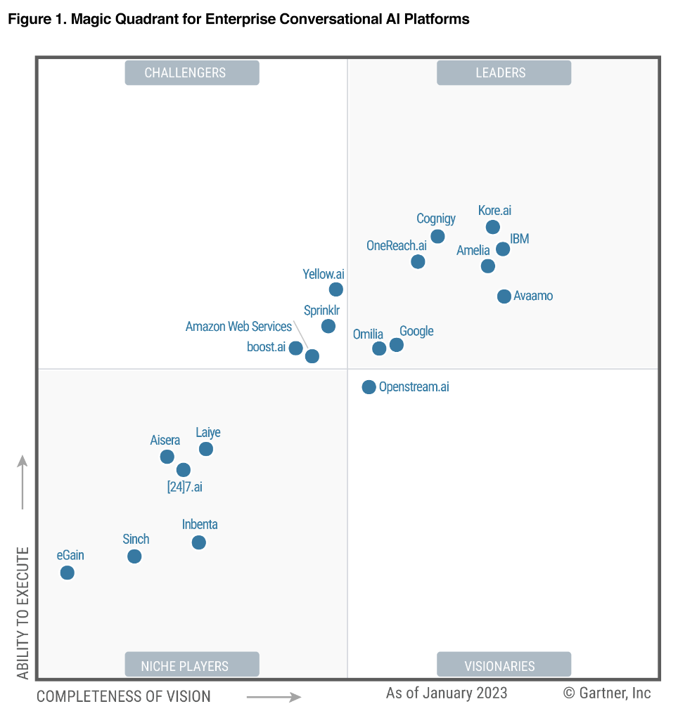
Biggest Business Impact of Generative AI
customer operations
interactions with customers
marketing & sales
generation of creative content

Slide 19
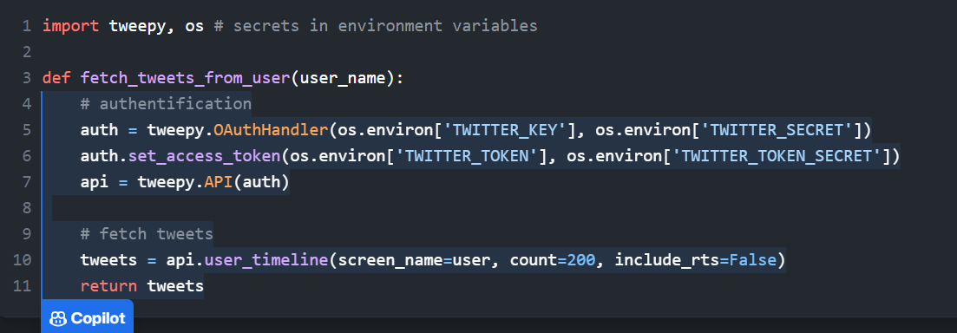
Coding Assistant
LLM: text-to-code
prominent example: GitHub Copilot

Slide 20
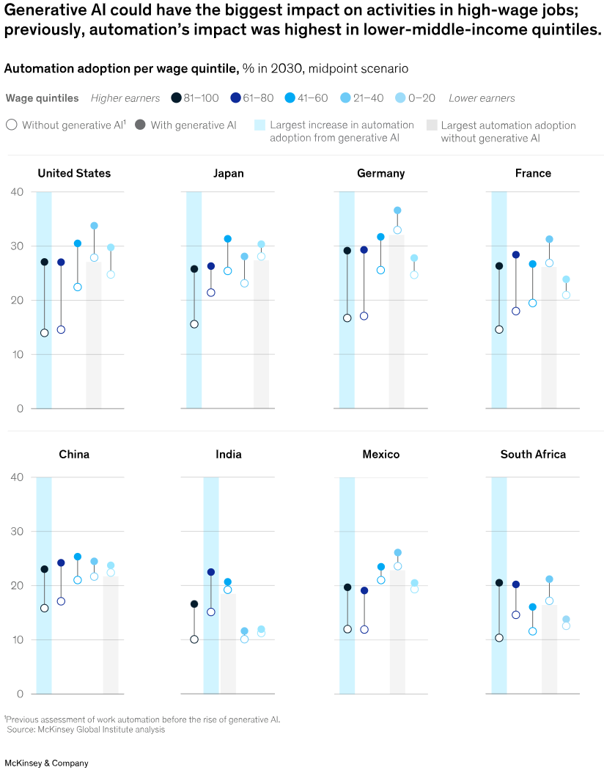
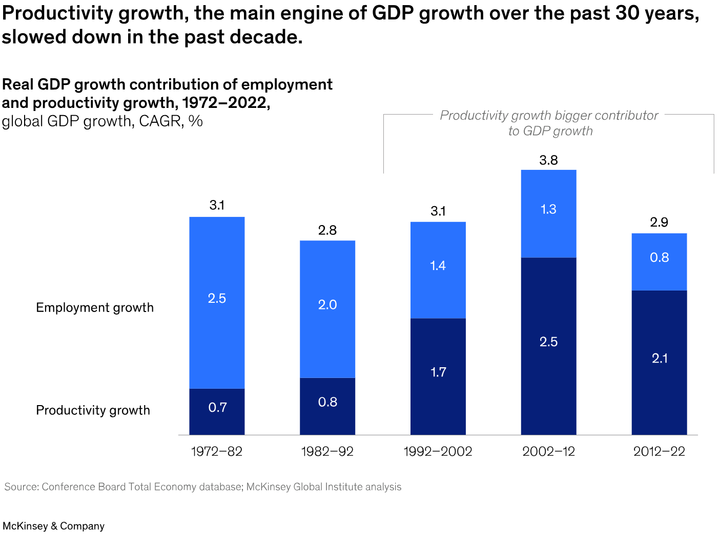
AI Potential
automate white-collar more than blue-collar jobs
(generative) AI could free up 70% of employees’ time
half of today’s work activities could be automated between 2030 and 2060

Slide 21
Engineering & Tech Stack

Slide 22






Scientific Python Stack

Slide 23


Deep Learning Frameworks
need for lots of memory and compute …

Slide 24






IaaS, PaaS, SaaS
example for managed service: Azure Kubernetes Service (AKS) for container orchestration

Slide 25
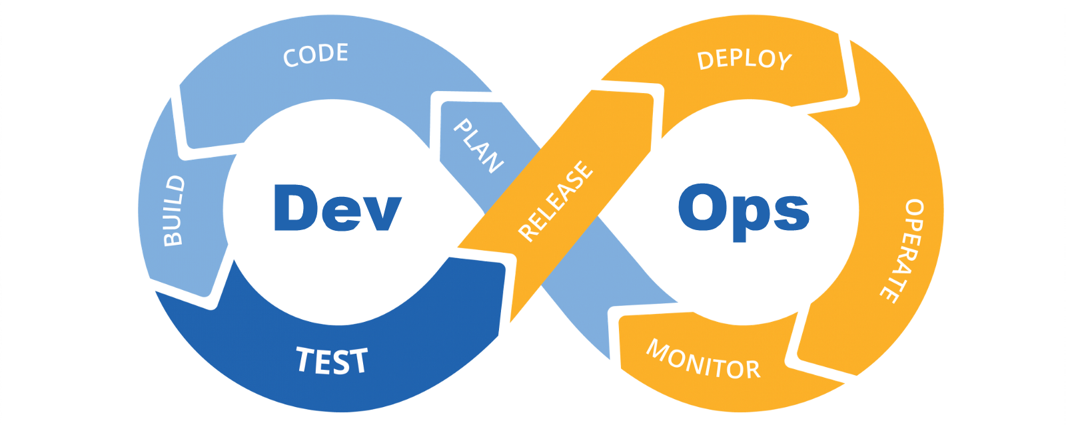
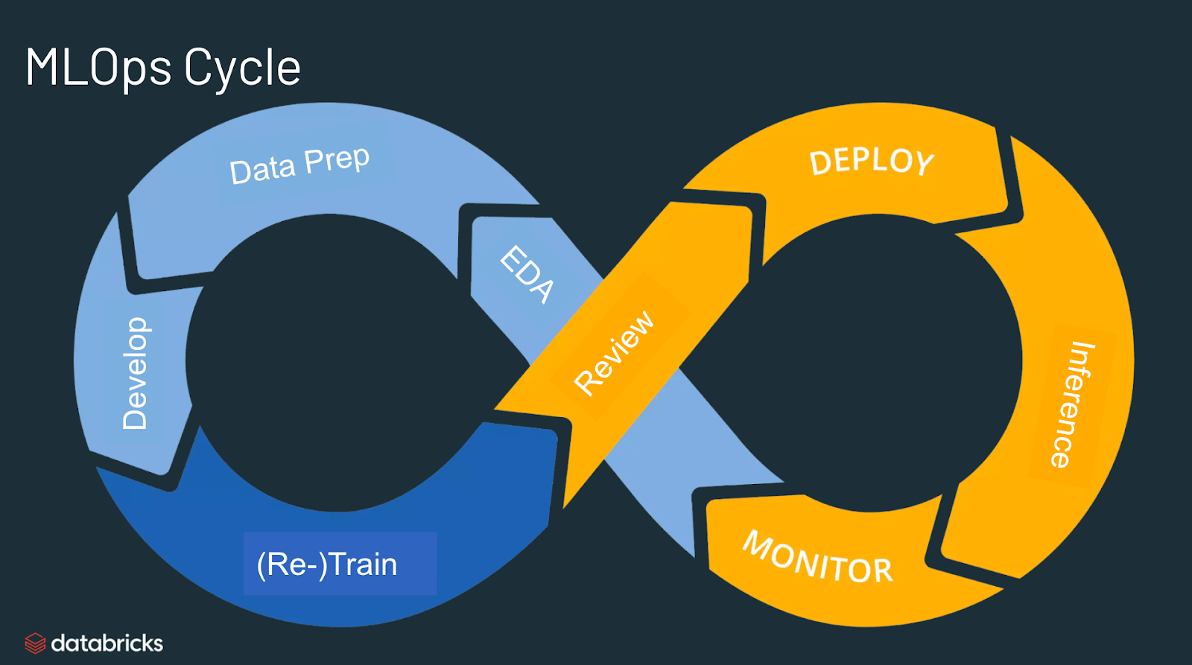
ML in Production
examples for managed ML services: Azure ML, SageMaker

Slide 26




Data Management
not only compute but also cloud-based data storage
data lake: raw data
data warehouse: integrated data
unification of data lake and warehouse: ETL → ELT
NoSQL example: graph database

Slide 27
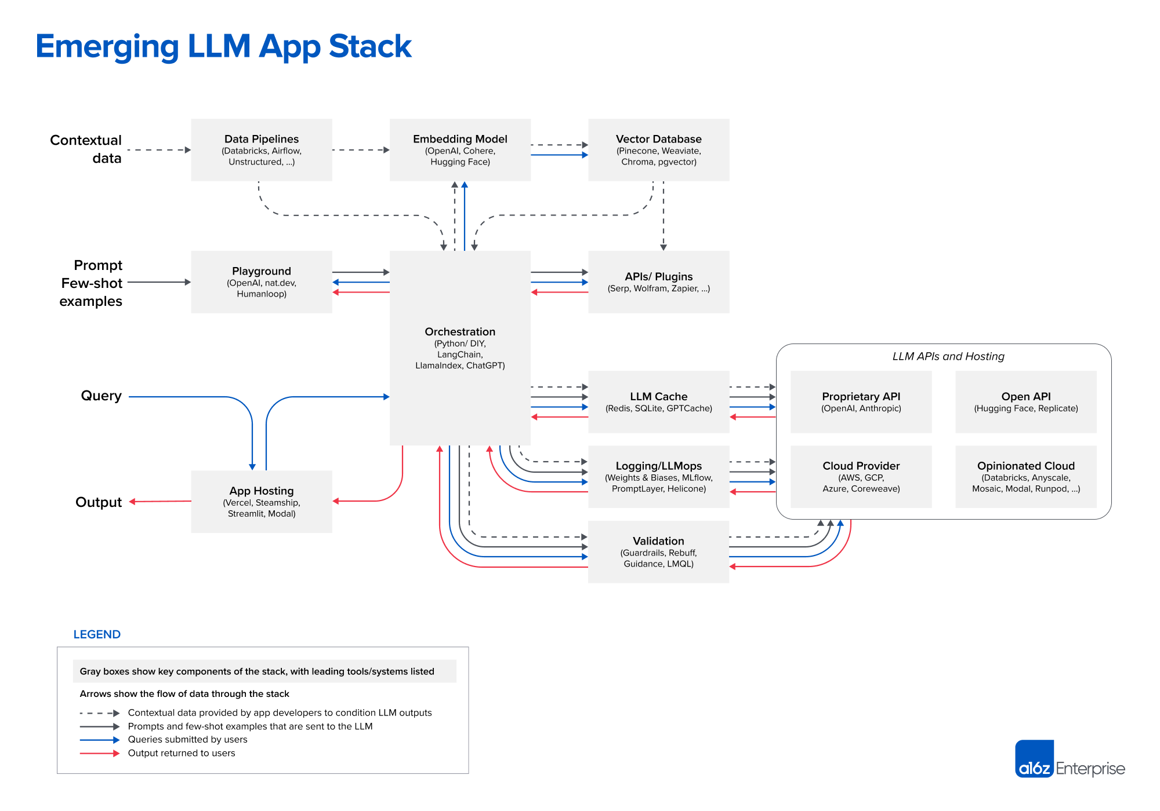

Slide 28
What The Future Holds: Autonomous Agents
learning from data
cyber
model:
cognition
and other inputs
and other decisions
multimodal
multitask
robotics:
action
agency
sensing:
perception
physical

